Slide 1
Exercise 5
The Protists

Slide 2
In this lab exercise, you observed the wide diversity of protistans. As you observe the organisms on this page. Classification of this group has been changing and studying them together is a matter of convenience, not an indication of evolutionary relationships. Notice the great diversity in this group. Some are autotrophs, some are heterotrophs whose characteristics make them more “animal-like”, others are more “fungus-like” and some cause disease in humans. Consult your lab manual for the role of each in its environment, the structures that you will need to recognize on each specimen, and their functions.

Slide 3
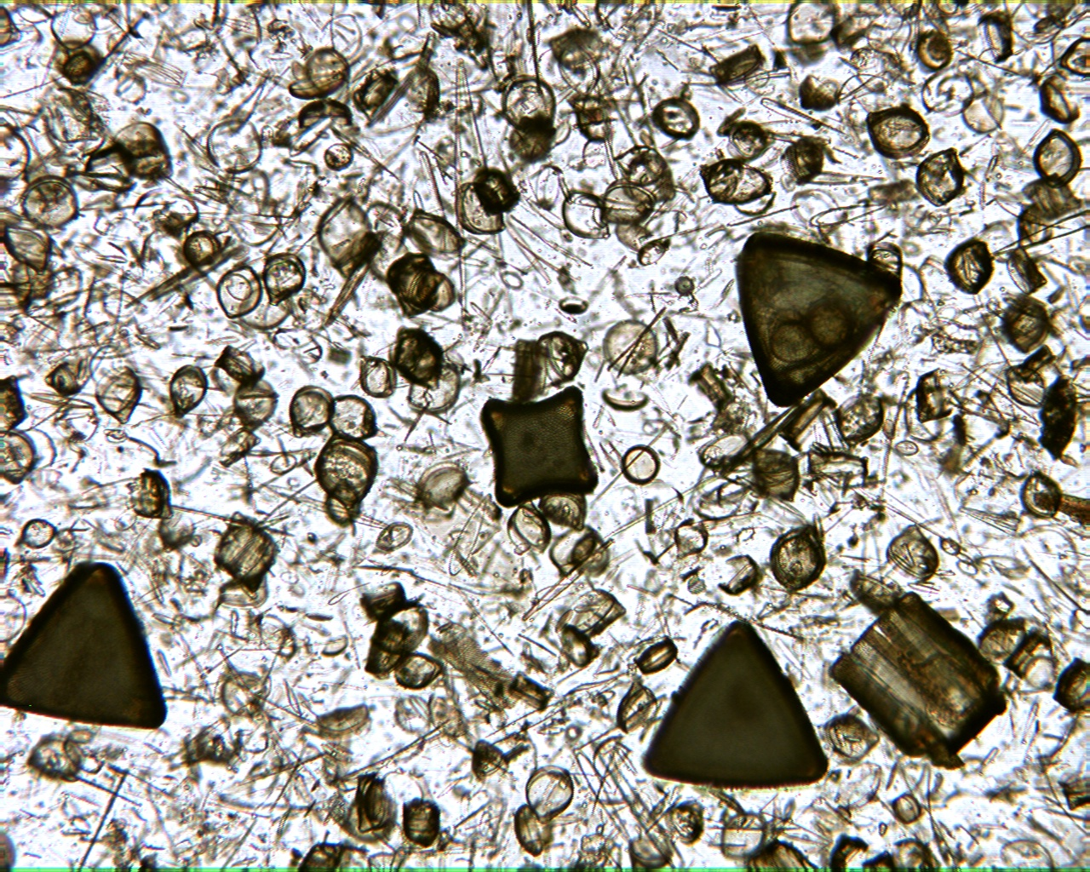
Diatom Shells 100X

Slide 4
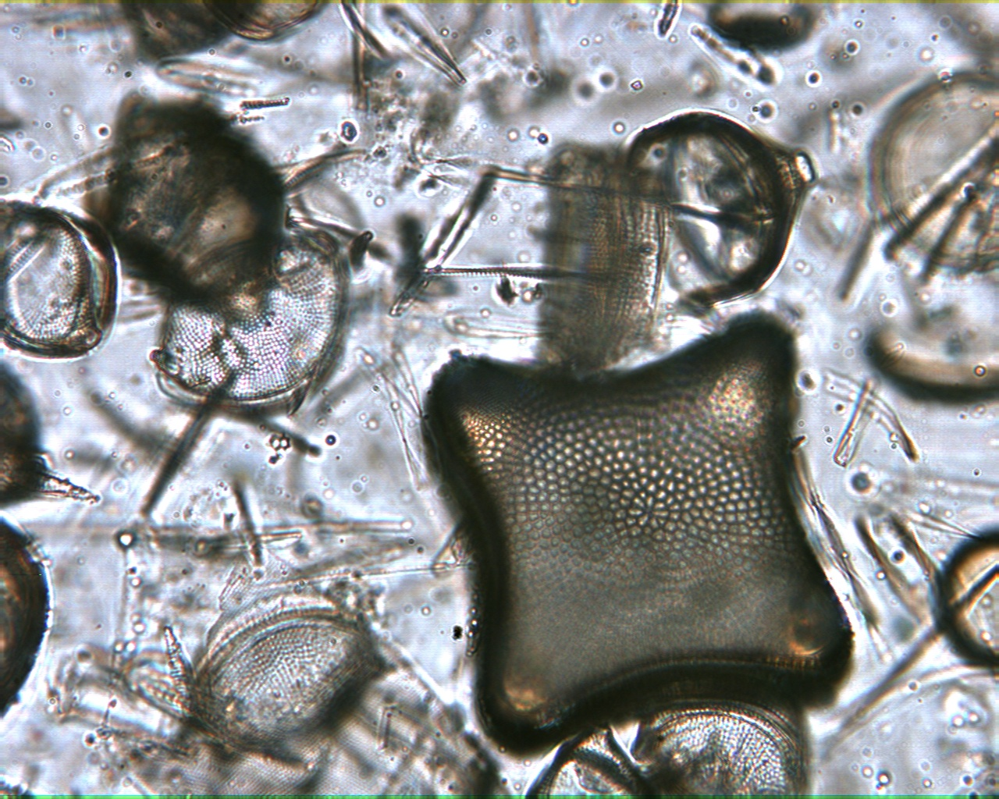
Diatom Shells 400X

Slide 5
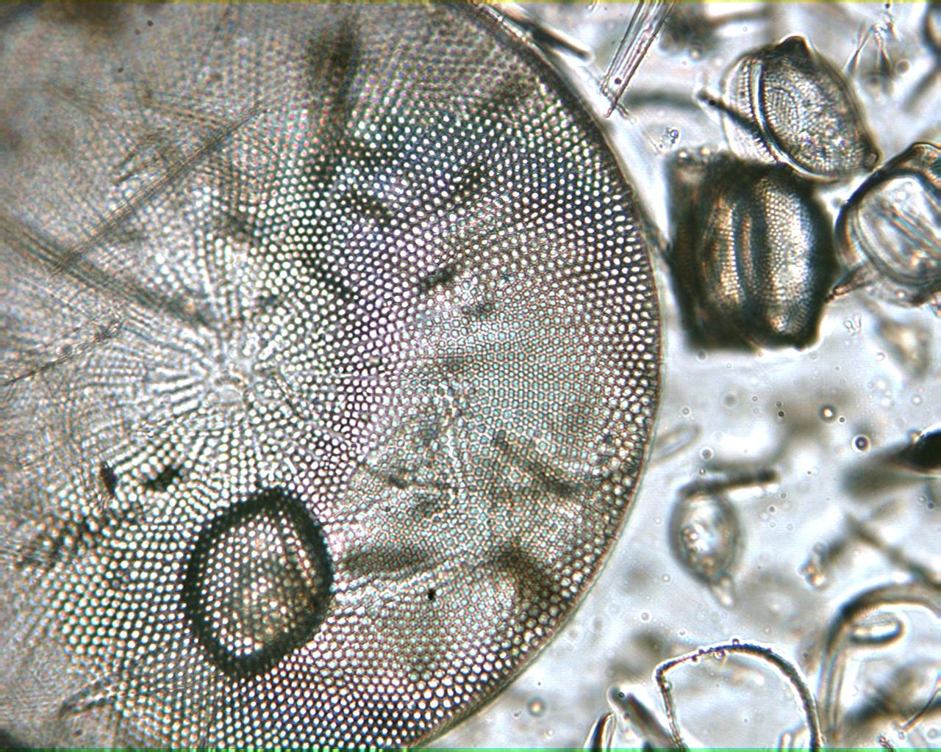
Diatom Shells 400X

Slide 6
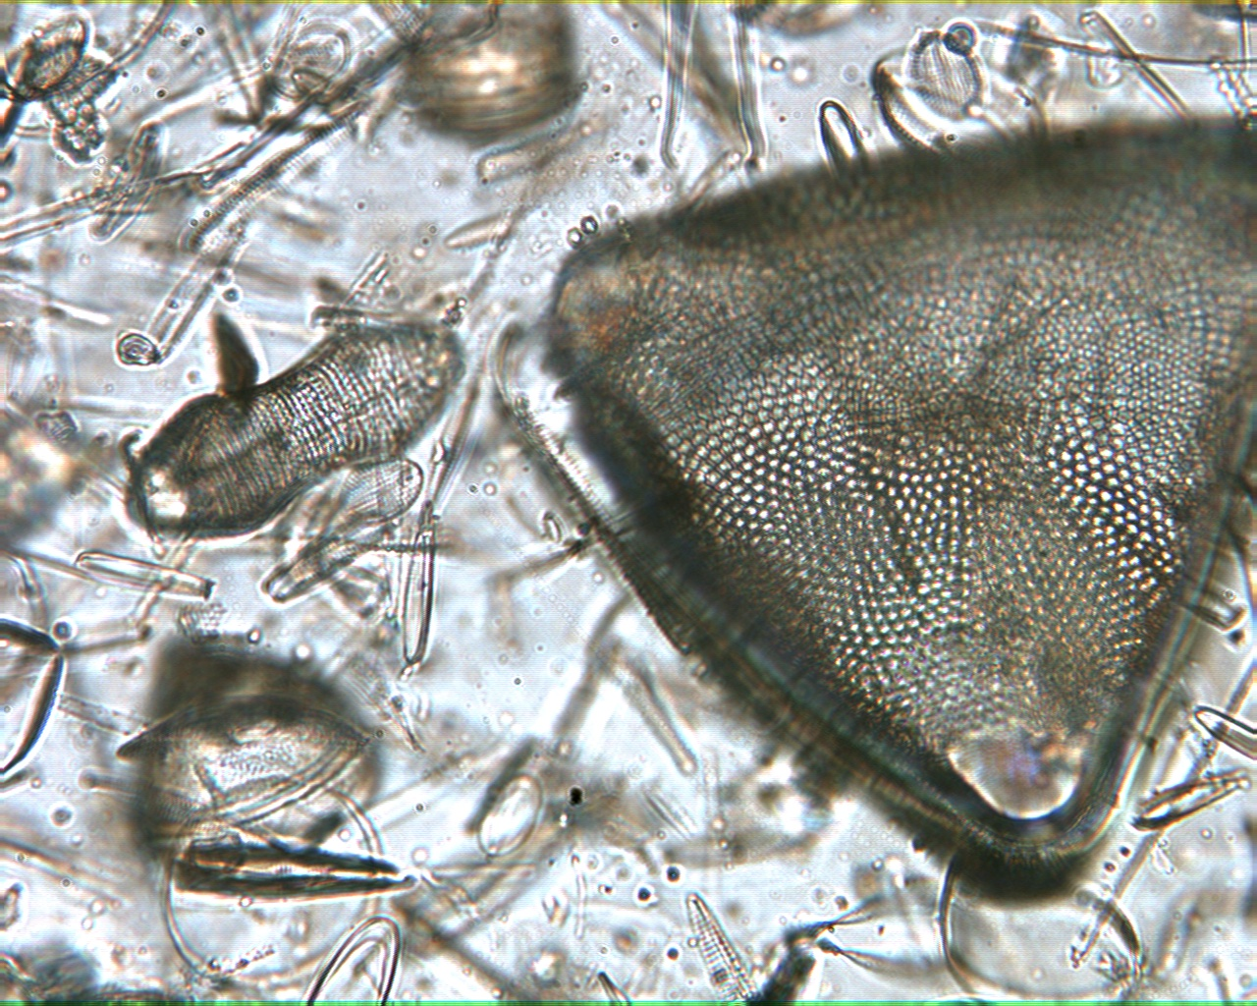
Diatom Shells 400X

Slide 7
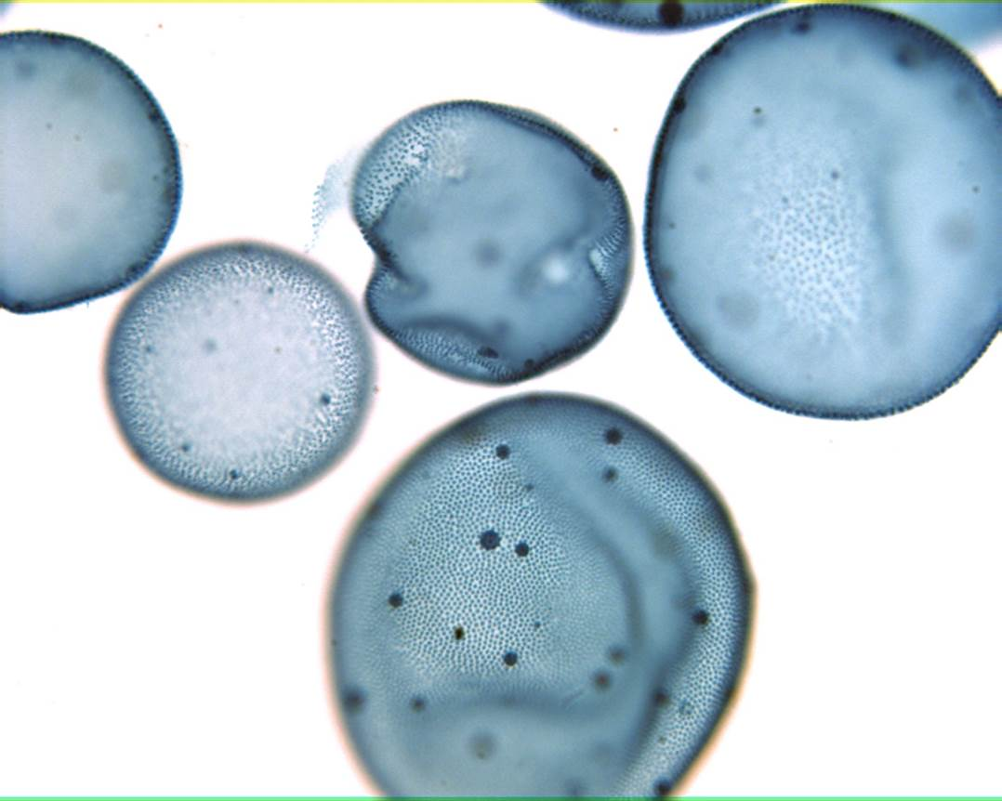
Volvox 40X

Slide 8
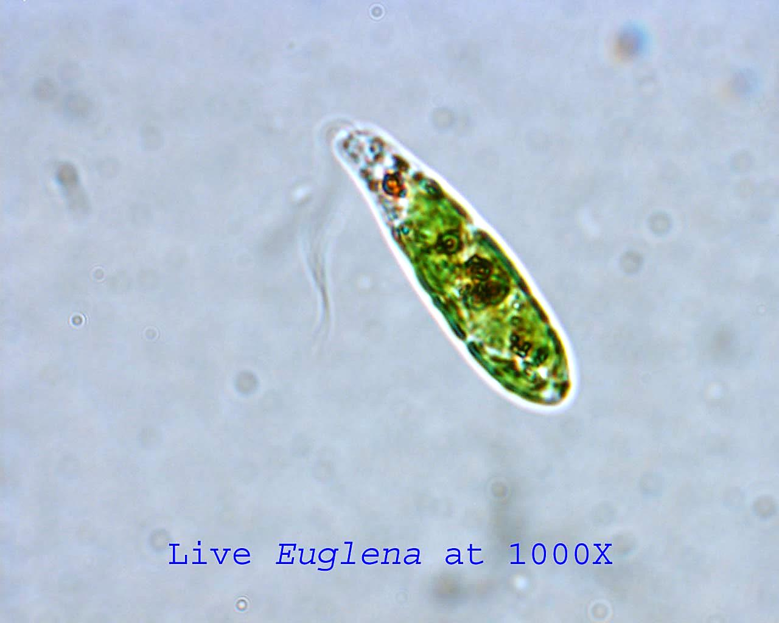
Euglena 1000X

Slide 9
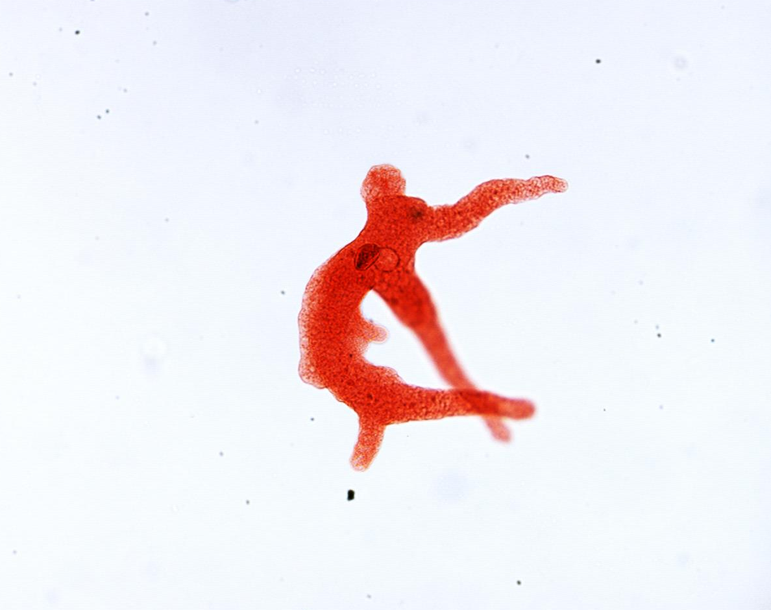
Amoeba 100X

Slide 10
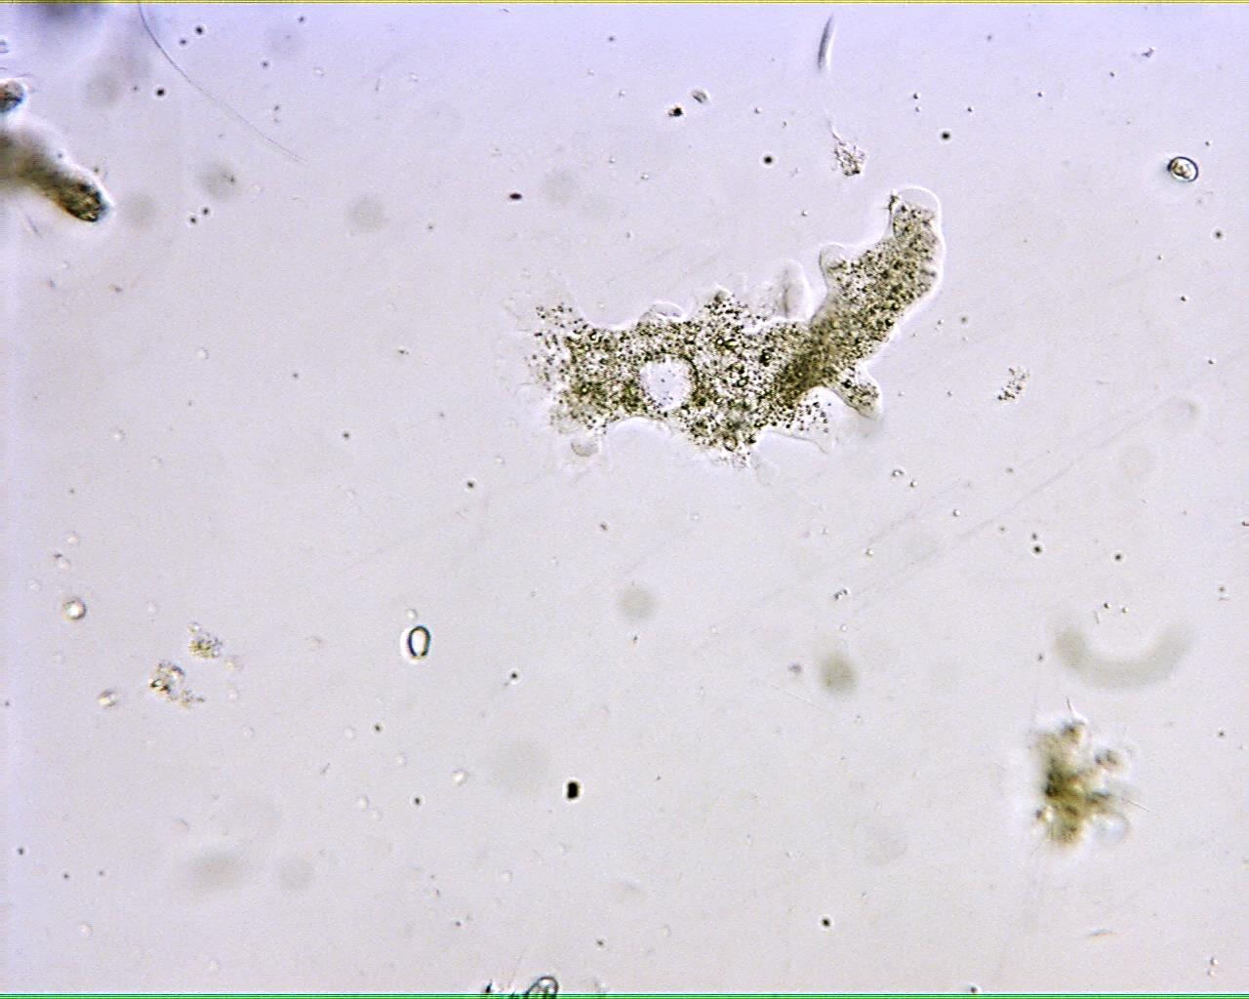
Live Amoeba 100X

Slide 11
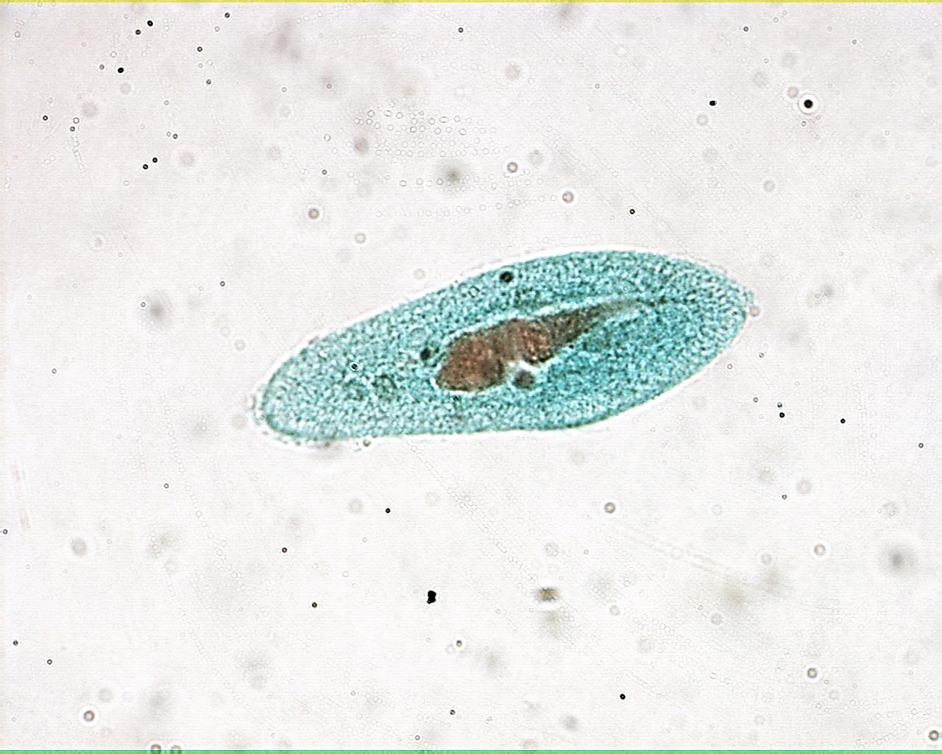
Paramecium 400X

Slide 12
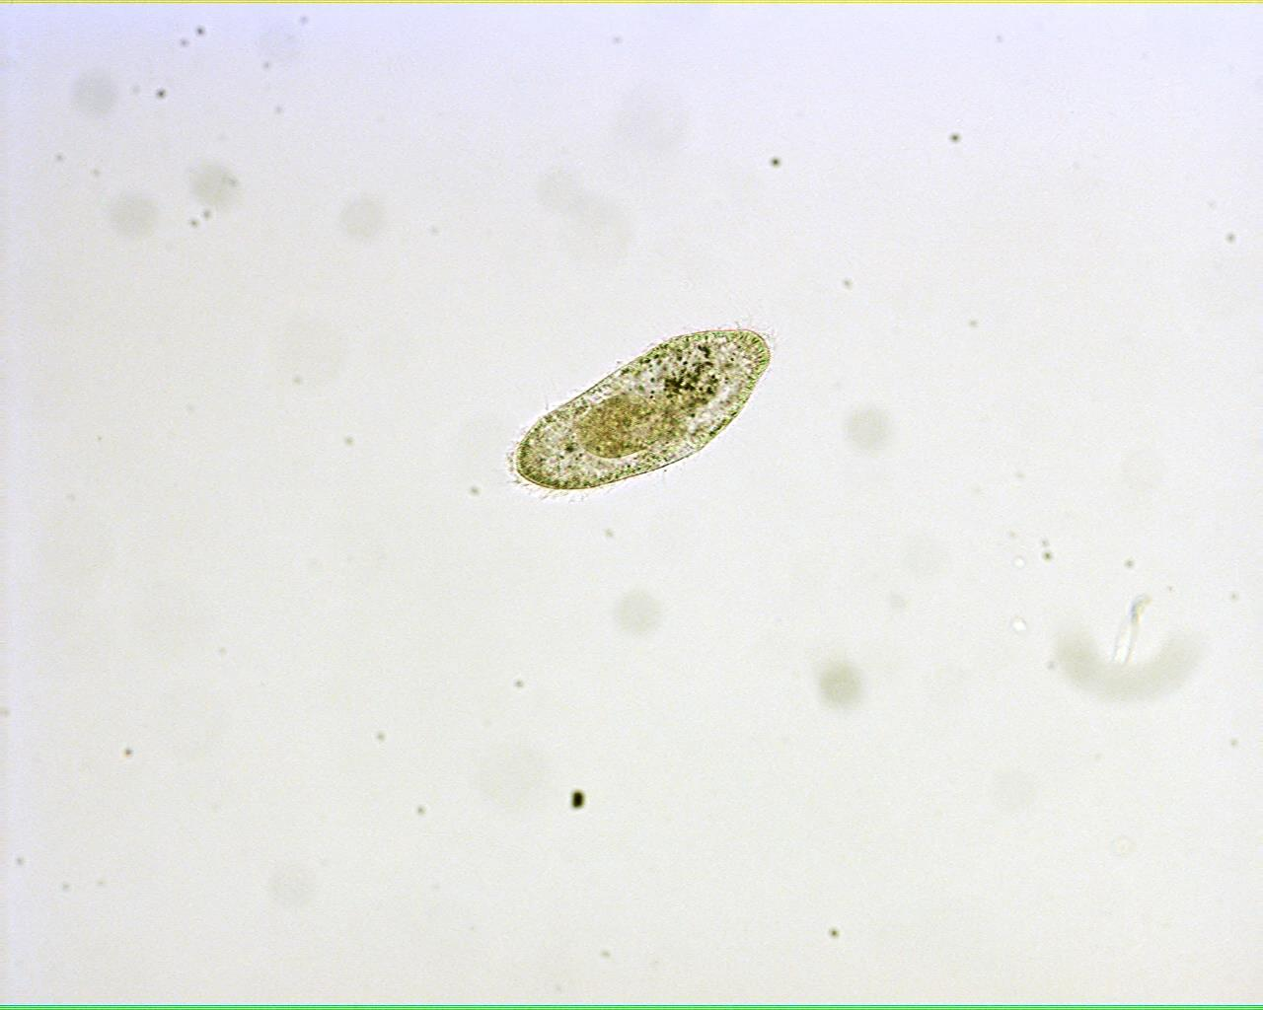
Live Paramecium 100X

Slide 13
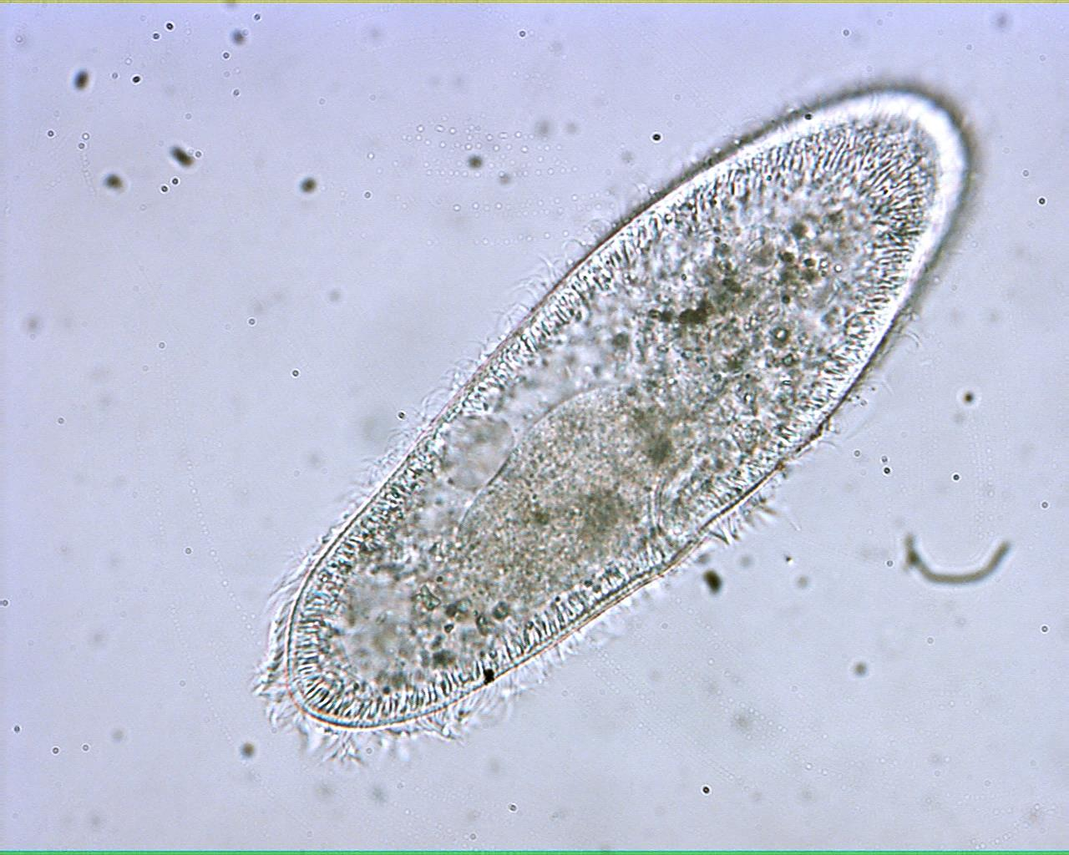
Live Paramecium 400X

Slide 14
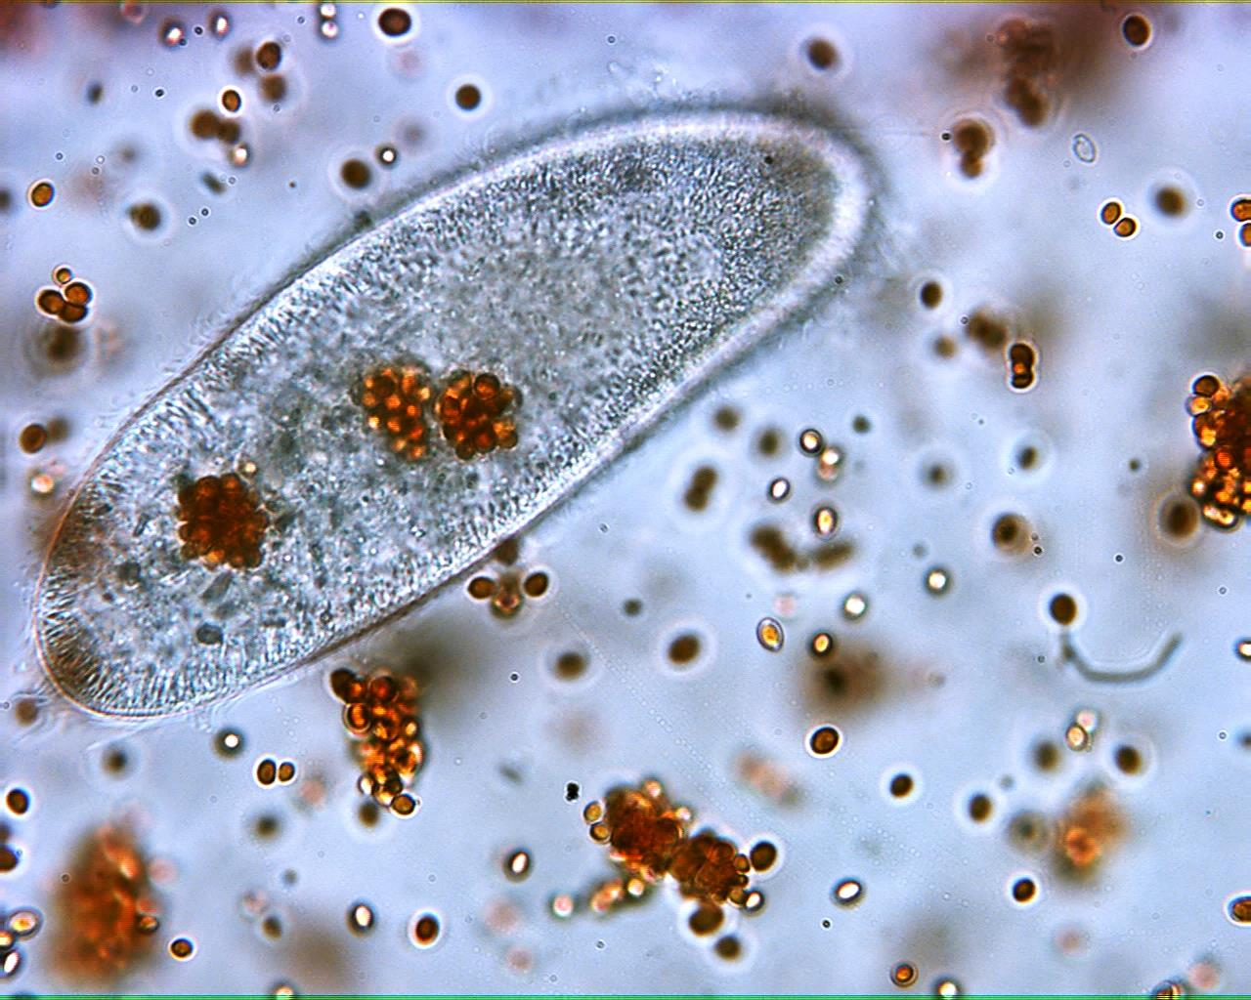
Paramecium Feeding 400X

Slide 15
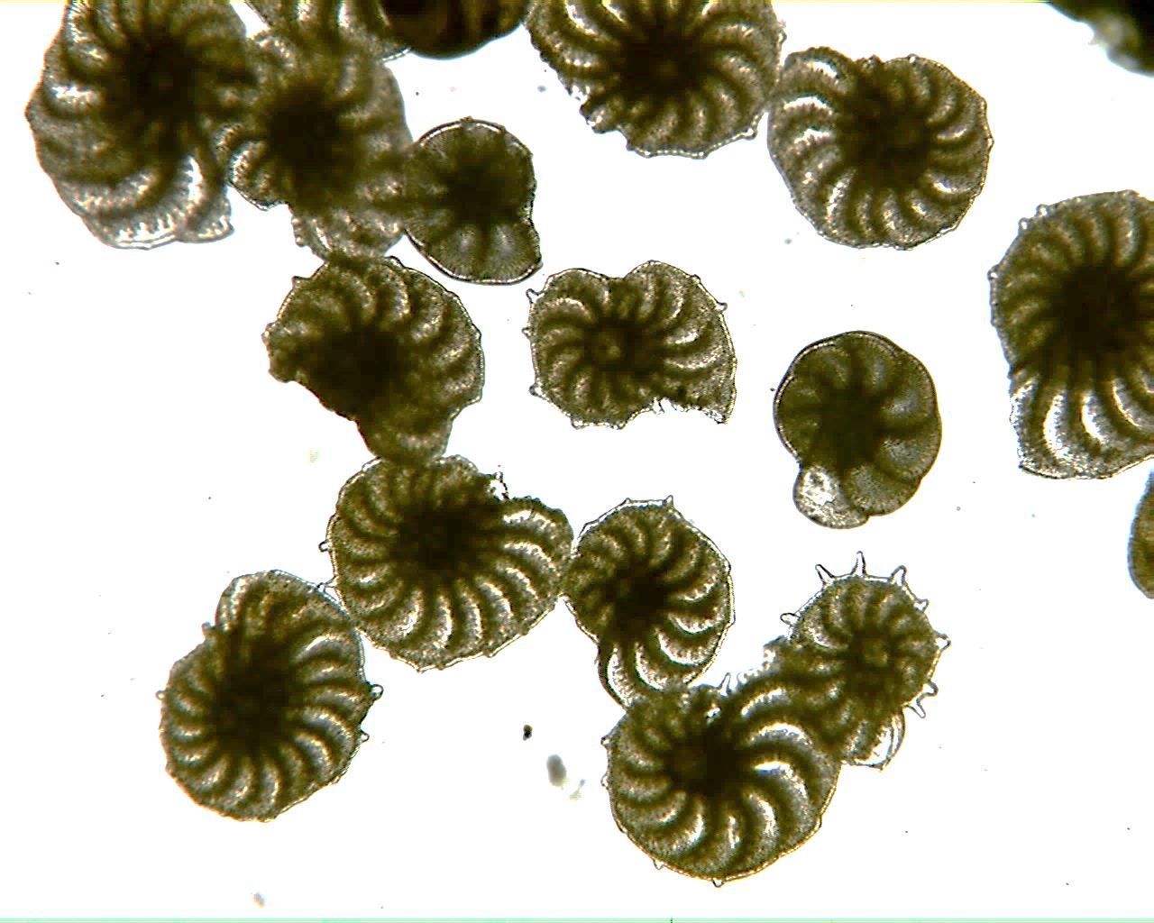
Foraminifera Tests 40X

Slide 16
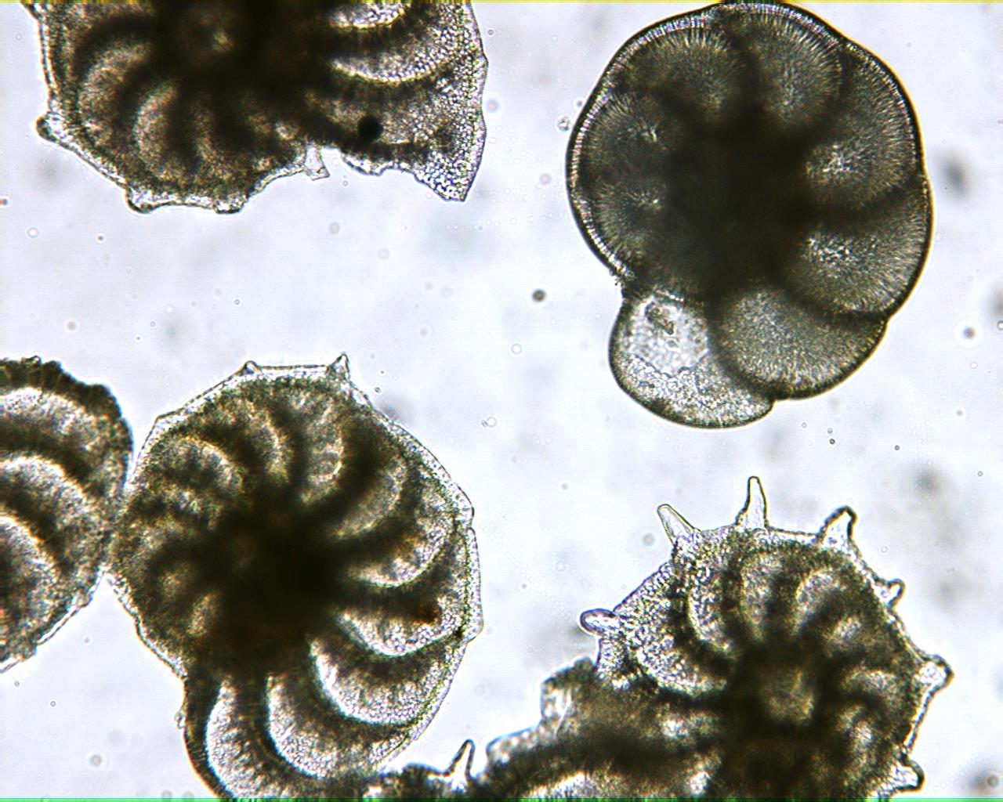
Foraminifera Tests 100X

Slide 17
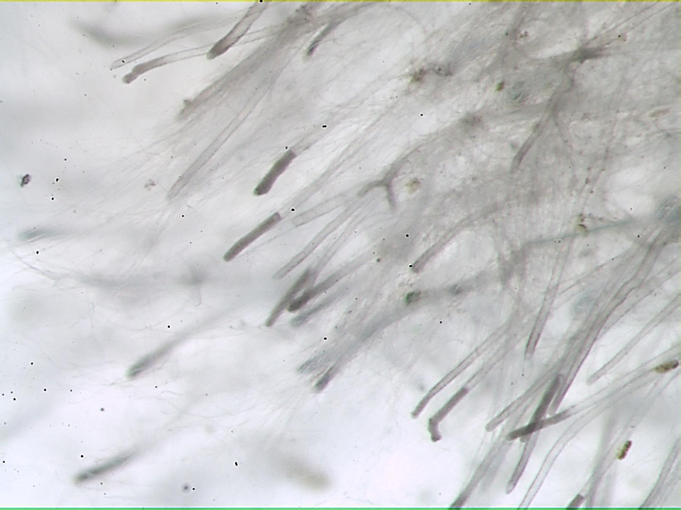
Live Water Mold

Slide 18
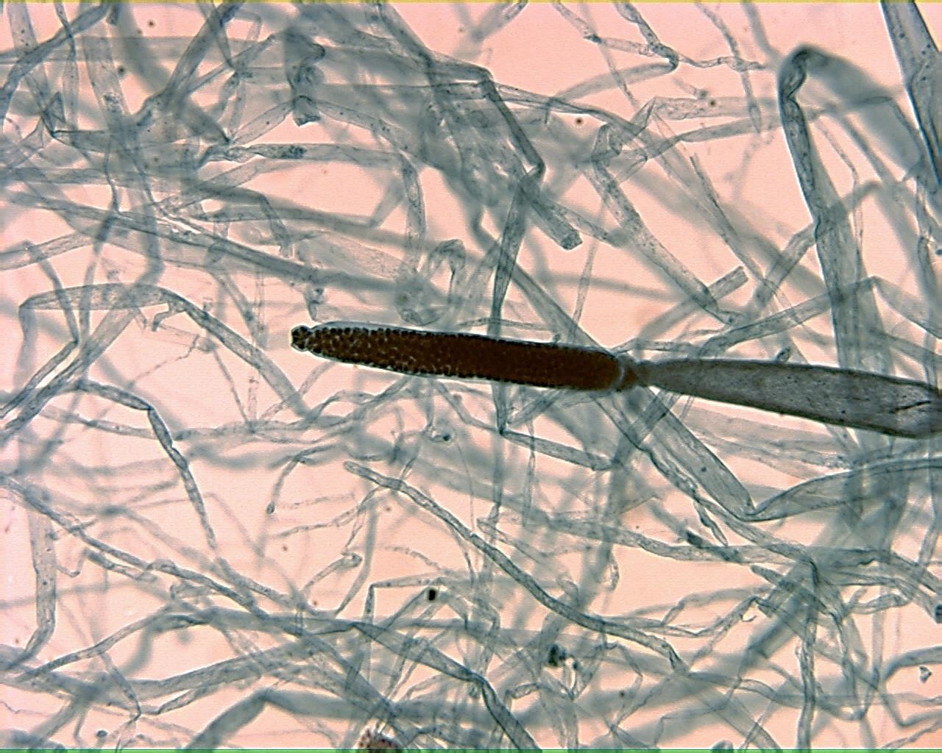
Saprolegnia Zoosporangium 100X

Slide 19
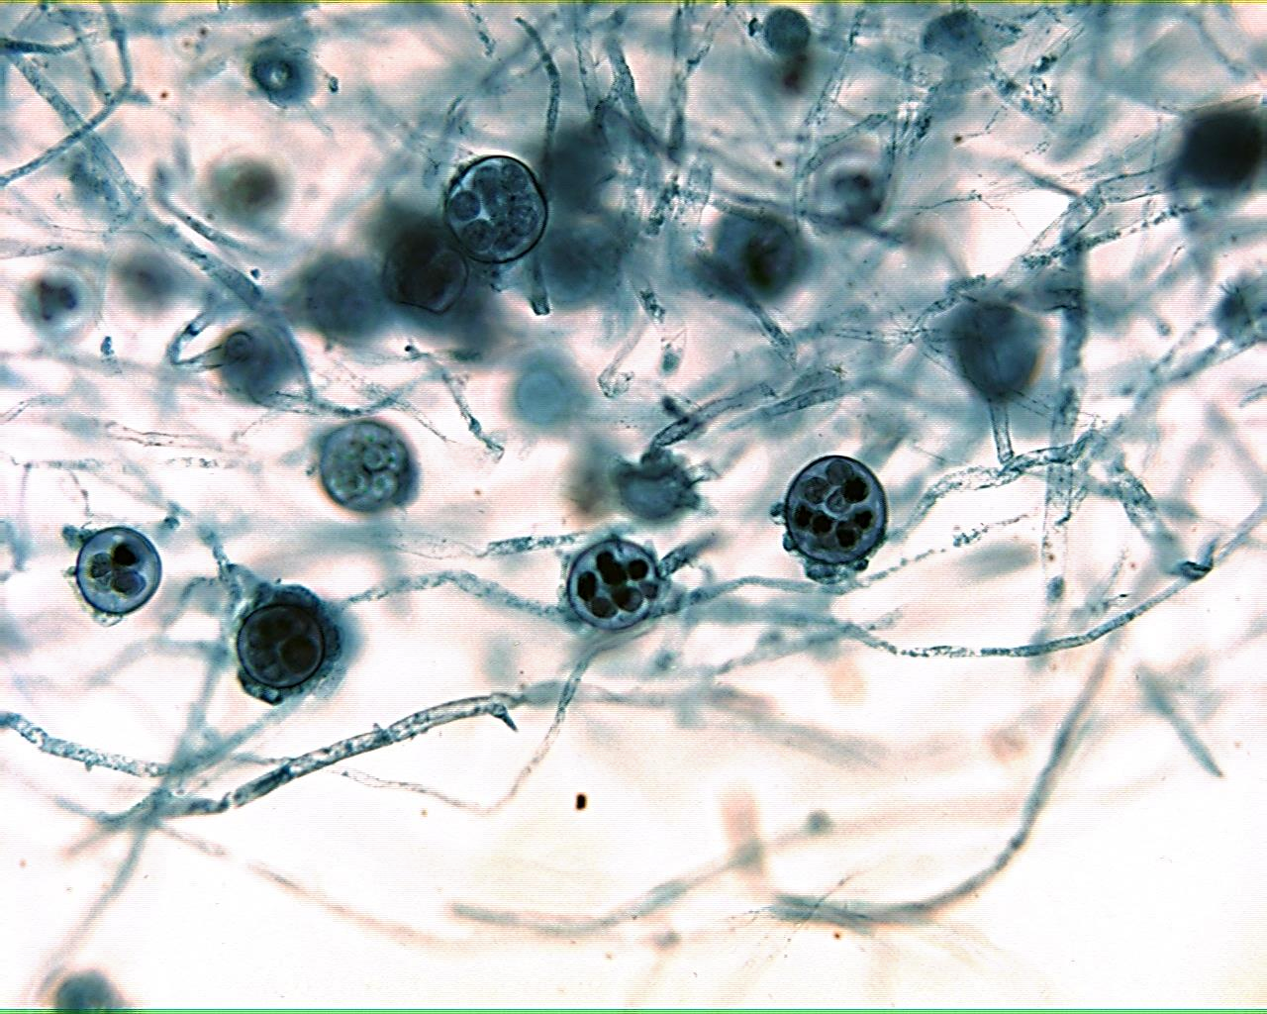
Saprolegnia Oogonia 100X

Slide 20
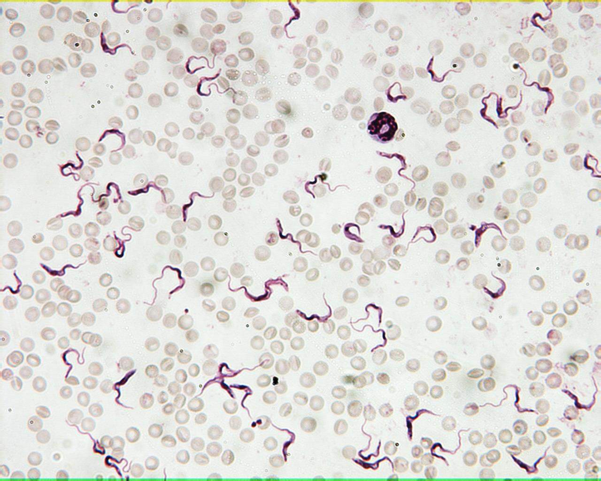
Trypanosoma 400X

